Slide 1


Malware Detection using Machine Learning
Phase 2
Nikhil Goparapu
Data 606 – Spring 2021
Instructor: Dr. Murat Guner

Slide 2
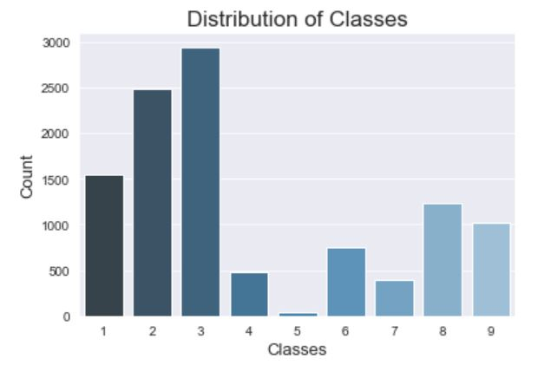

Distribution of Classes
The classes are non uniformly distributed.
The dataset is imbalanced.
Notes:
The histogram on the right shows the distribution of the classes in my dataset.
We can clearly see that the classes are not uniformly distributed.
The majority classes are 1,2 and 3 and minority classes are 5, 4 and 7.
Class 3 occurs highest number of time while 5 occurs the least.

Slide 3
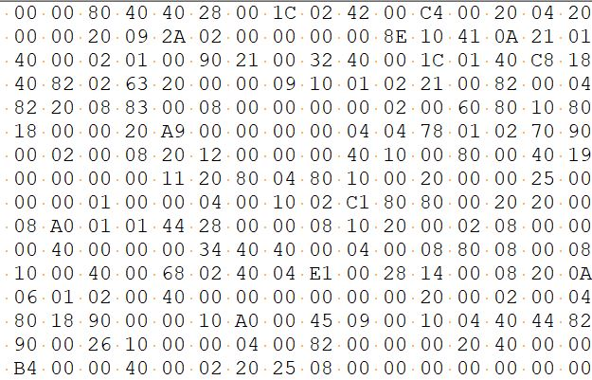
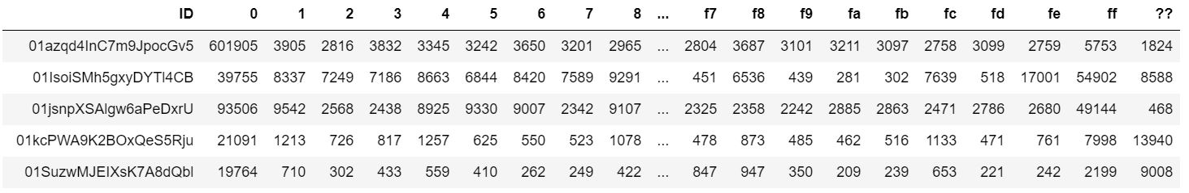
Extracting Unigrams from byte file
Image of a raw byte file
Unigrams dataframe
Notes:
The image on the top is what a raw byte file looks like.
It is a hexadecimal representation of the file's binary content. In total there are 256 unique values.
Just as we extract unigrams from documents, I have extracted unigrams froms the raw byte file and created a dataframe (second image below) . Each row in the dataframe represents a byte file. Each column represents a unique hexadecimal value. And each cell in the dataframe represents the number of occurances of that hexadecimal value in that byte file. The last column (??) in the dataframe represents the count of missing values in each byte file.

Slide 4
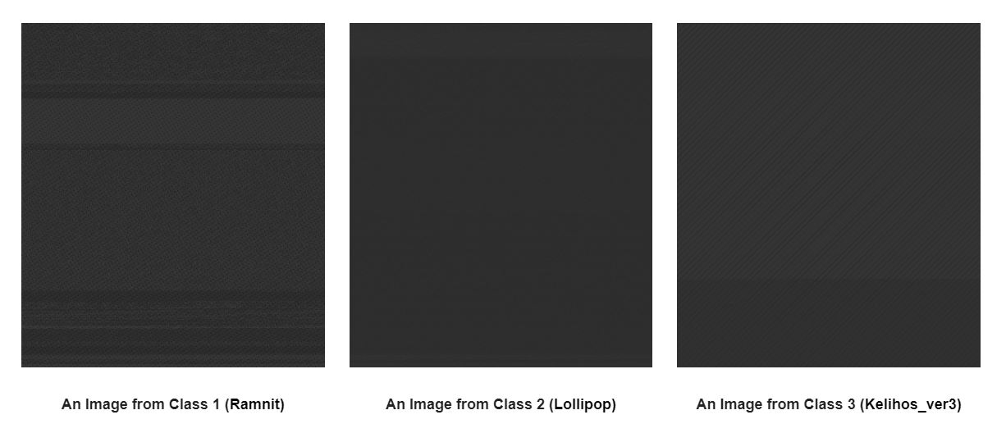
Images of byte file
Notes:
I have extracted images from the byte files of the malware. Below are the sample images of the byte file of 3 classes of malware. We can use the pixel values of these images as features in our dataset.

Slide 5
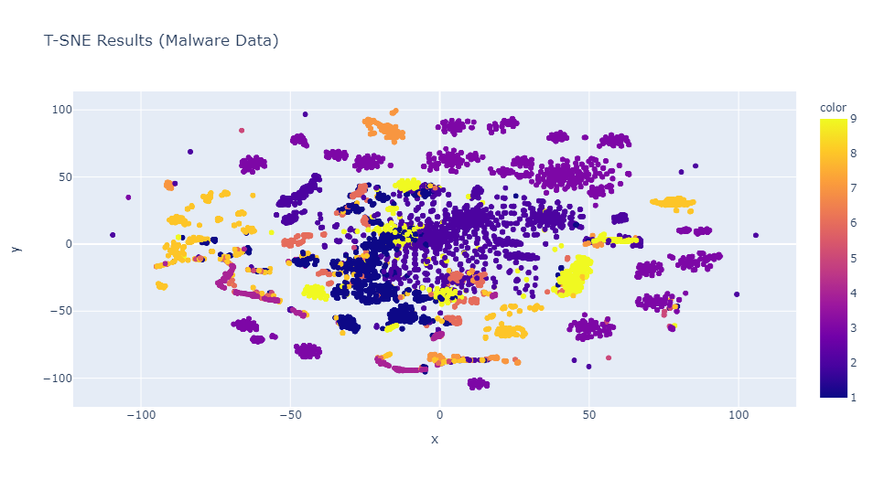
3. Visualizing the 257-D Unigrams data on a 2-D plane using T-SNE
Notes:
Visualizing the 257-D Unigrams data on a 2-D plane using T-SNE
I have reduced the 257-dimensional data to 2-dimensional data using T-SNE. Below is the scatter plot of the 2-Dimensional data. Each color represents a different class. We can see that similar colored points are clustered together with some overlap in the center of the image.
T-SNE mainly preserves the local structure of the data while converting high dimensional data to low dimensional data. It also suffers from crowding problem. This might be the reason that we see some overlap in the center of the image. There is a high chance that these data points are well separated in the 257-dimensional space.

Slide 6

Train and Test data
Used the unigrams dataset for modeling
It consists of 10868 rows and 257 columns.
Training set: 80%
Testing set: 20%
Sampling Technique: Stratified Sampling.
Notes:
I have used the unigrams dataset for modelling.
I have taken 80% of data as training data and 20% of the data as test data.
As the classes in my dataset are not uniformly distributed, I have used stratified sampling to sample my dataset. Stratified sampling maintains same distribution in both training and testing set

